Slide 1
Hotel Reservation Analysis with SQL
Presenter: Rahma Ahmed

Slide 2

Our Data
This dataset provides a rich source of information about guest behavior and reservation characteristics. By leveraging SQL queries, we can extract valuable insights from this data.
The dataset includes information on hotel reservations.
Columns include details like:
Booking ID (unique identifier)
Number of adults and children
Number of weekend and weekday nights
Meal plan, room type, lead time, arrival date
Market segment, average price per room, and booking status

Slide 3

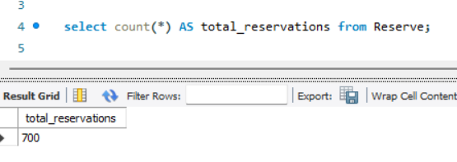
Question 1:
Total Reservations
This query retrieves the total number of reservations in the dataset. This provides a basic understanding of the dataset's size and scope.
This data can be used for capacity planning, and resource allocation
Back to Agenda

Slide 4
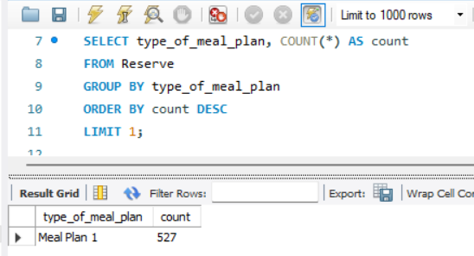
Question 2:
Most Popular Meal Plan
Identifying the most popular meal plan reveals guest preferences for dining options.
The hotel can use this information to:
Promote the popular meal plan in marketing campaigns.
Consider offering additional options or variations based on guest demand.
Back to Agenda

Slide 5
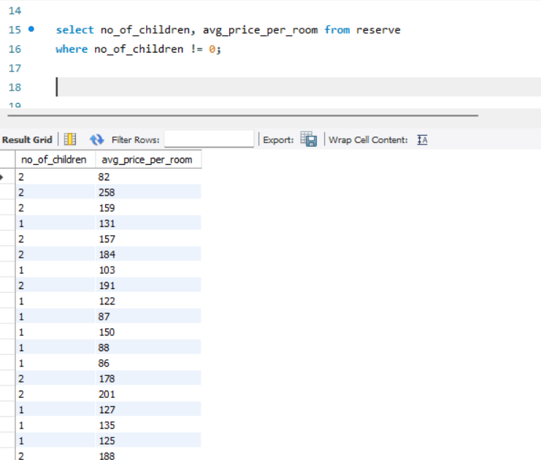
Question 3:
Average Price with Children
The average price per room for reservations with children sheds light on pricing trends for families or groups.
The hotel can:
Analyze if the pricing strategy for larger groups is appropriate.
Consider offering targeted promotions or packages for families.
Back to Agenda

Slide 6
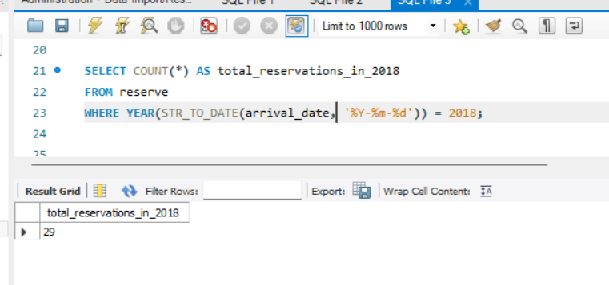
Question 4:
Reservations in 2018
Knowing the number of reservations for a specific year (e.g., 2023) helps track yearly trends and compare them to previous years.
This information can be used for:
Seasonal forecasting and identifying peak periods.
Budgeting and resource allocation based on anticipated demand.
Back to Agenda

Slide 7
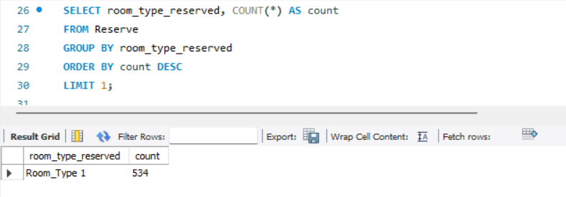
Question 5:
Most Common Room Type
dentifying the most frequently booked room type reveals guest preferences for room size, amenities, or features.
The hotel can use this knowledge to:
Ensure adequate inventory of the most popular room types.
Consider offering upgrades or promotions for less popular room categories.
Back to Agenda

Slide 8
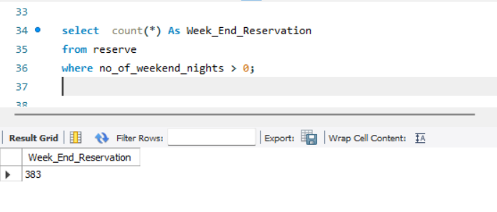
Question 6:
Weekend Reservations
The number of reservations that include at least one weekend night indicates the demand for weekend stays.
This helps the hotel:
Plan staffing levels and prepare for increased service needs during weekends.
Craft targeted marketing campaigns or weekend packages to capitalize on this demand.
Back to Agenda

Slide 9
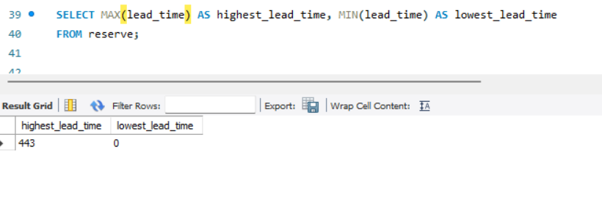
Question 7:
Lead Time Range
This query finds the highest and lowest lead times (booking days) in the dataset.
This can reveal patterns in booking behavior, such as how far in advance guests typically book.
Back to Agenda

Slide 10
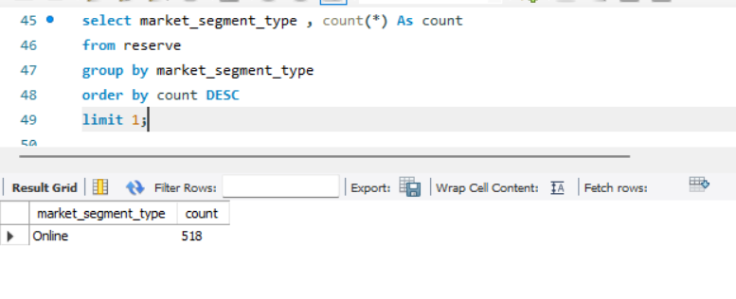
Question 8:
Most Common Market Segment
Identifying the most common market segment (e.g., corporate travelers, families) allows the hotel to tailor its marketing and promotional efforts to that specific audience.
Understanding their preferences can help in designing targeted packages, amenities, and loyalty programs.
Back to Agenda

Slide 11
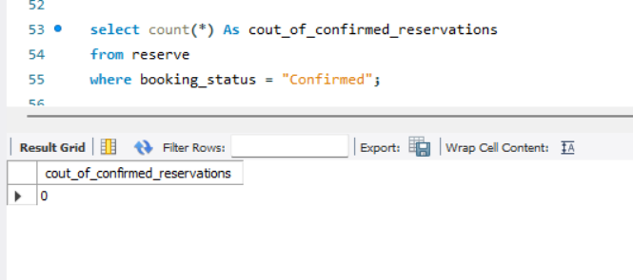
Question 9:
Confirmed Reservations
Knowing the number of confirmed reservations provides a clearer picture of actual booked stays, which is crucial for revenue forecasting and resource allocation.
Analyzing trends in confirmed reservations helps assess the effectiveness of marketing campaigns and pricing strategies.
Back to Agenda

Slide 12
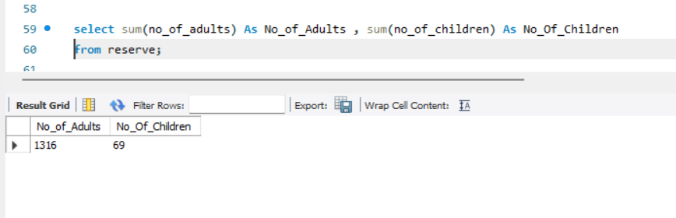
Question 10:
Total Adults and Children
The total number of adults and children helps determine overall guest capacity and occupancy rates.
This data can inform decisions about room size availability, amenities tailored for families (e.g., cribs, high chairs), and staffing needs during peak seasons.
Back to Agenda

Slide 13
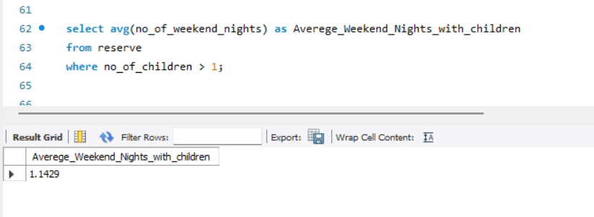
Question 11:
Weekend Nights with Children
Understanding the average number of weekend nights for reservations with children helps predict demand for weekend family getaways.
This information can be used for targeted weekend promotions or packages catering to families.
Back to Agenda

Slide 14
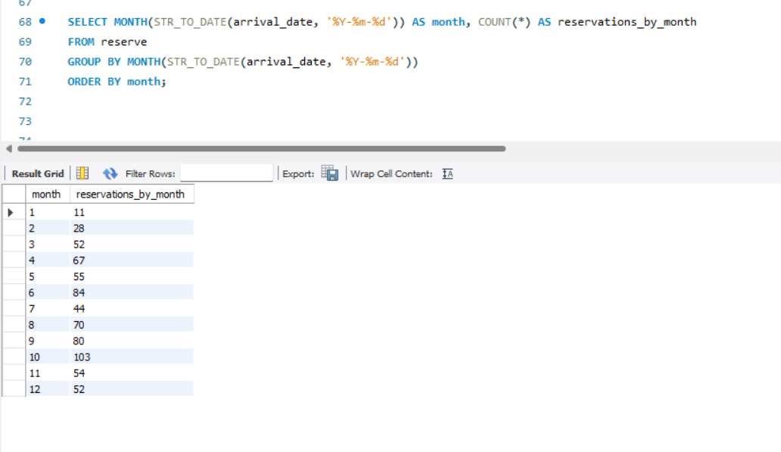
Question 12:
Reservations by Month
Identifying peak and off-peak months in terms of reservations helps with revenue management strategies.
The hotel can adjust pricing, staffing levels, and marketing campaigns based on seasonal trends.
Back to Agenda

Slide 15
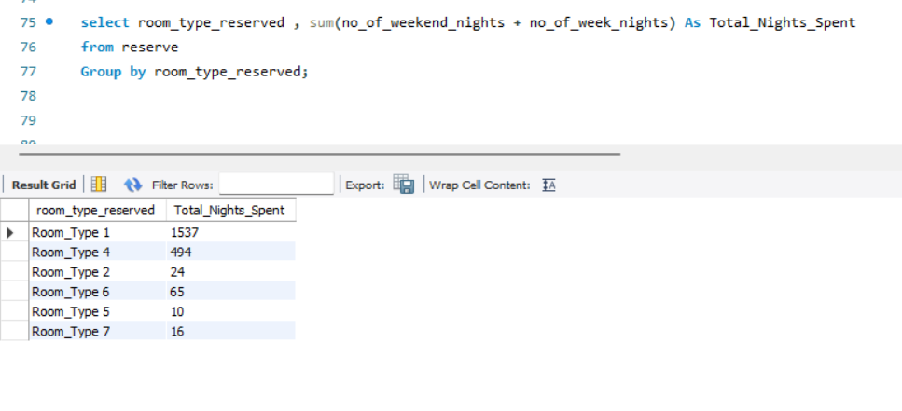
Question 13:
Nights Spent by Room Type
Analyzing the average number of nights spent for each room type helps understand guest preferences and room utilization.
This information can be used to optimize room pricing based on demand and ensure the right mix of room types is available.
Back to Agenda

Slide 16
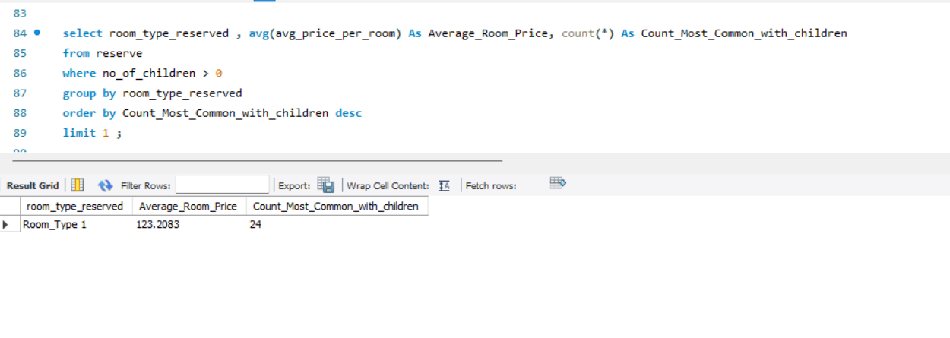
Question 14:
Popular Room Type with Children
Identifying the most popular room type for families along with its average price allows the hotel to optimize pricing strategies for this segment.
Understanding family preferences for room types can help in offering targeted amenities or upgrades.
Back to Agenda

Slide 17
Question 15:
Market Segment with Highest Price
Knowing the market segment that generates the highest average room price helps the hotel identify its most valuable customer segments.
This allows them to tailor marketing efforts and potentially offer exclusive perks or loyalty programs to these segments to retain their business.
Back to Agenda

Slide 18




Thank You
Drag and drop your photo or video! Click the sample photo or video and delete. Select yours from the uploads tab, drag, and then drop inside the frame!

